Slide 1




SMART ATTENDANCE SYSTEM
USING FACE RECOGNITION
Automated Student Verification & Database Recording
PROJECT TEAM MEMBERS
V. SHIVA VENKATA SAI
V. SATHVIK
R. PRANAV
Automated facial scanning matched against stored biometric vectors in MySQL database.

Slide 2






ABSTRACT
The Smart Attendance System is a database-driven attendance management application designed to automate student attendance marking using real-time face recognition technology.
Core Execution Pipeline
Student Credential Entry (Dept / Sec / Roll No)
Initially, essential student information—including Name, Roll Number, Department, Section, and Registered Biometric Face Data—is stored securely in the MySQL database.
Live Camera Face Capture & Feature Extraction
During attendance, students enter their credentials and undergo live face scanning. If the captured face matches the registered biometric dataset associated with the student's record, attendance is marked as "Attendance Successfully Provided".
Biometric Face Matching against Stored Dataset
MySQL Database Record Verification
The system eliminates proxy attendance, reduces manual administrative overhead, and maintains a centralized, tamper-proof attendance log.
Attendance Confirmation & Status Update

Slide 3



CURRENT SYSTEM VS PROPOSED SYSTEM
Current System (Manual)
Proposed System (Automated DBMS)
Manual attendance using physical paper registers.
Fully automated face-recognition-based logging.
Time-consuming process causing class instruction delays.
Instantaneous scanning and attendance verification.
High probability of human errors during record entries.
Centralized MySQL database ensuring high data integrity.
High vulnerability to proxy and fraudulent attendance.
Completely eliminates proxy attendance through biometric validation.
Difficult to archive and aggregate historical records.
Rapid query execution for instantaneous attendance retrieval.
Requires tedious manual calculations for percentage reports.
Automated calculation of student attendance percentages.

Slide 4









SOFTWARE AND HARDWARE REQUIREMENTS
Software Requirements
Hardware Requirements
Frontend Technologies HTML, CSS, JavaScript
Processing Device Computer / Workstation / Laptop
Database Management MySQL Database Server
Optical Capture High Definition Webcam (720p minimum)
Face Recognition Module Computer Vision / Face Matcher API
Memory & Processor Min. 4 GB RAM | Dual-Core CPU or better
Development Environment & OS VS Code IDE | Windows / Linux OS
Storage & Connectivity 10 GB Storage | Local Network / Wi-Fi

Slide 5

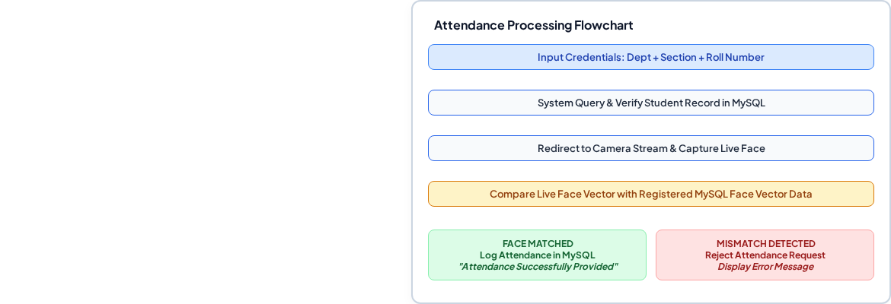
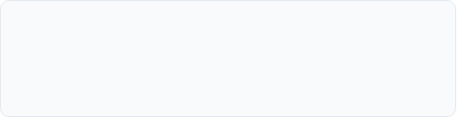
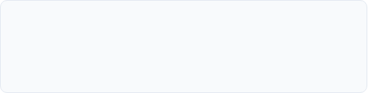




TECHNICAL DETAILS & SYSTEM WORKFLOW
Stack Configuration
MySQL Main Schema Attributes
Student Name
Roll Number (PK)
Department
Section
Face Vector Data
Attendance Logs
SYSTEM COMPONENT FLOW
HTML/CSS/JS
Vision Module
Record Store

Slide 6



THANK YOU!
SMART ATTENDANCE SYSTEM USING FACE RECOGNITION
Department of Computer Science & Engineering | DBMS Project Viva

